Slide 1
Data Mining: Data
Introduction to Data Mining
Lecture by
Shangsong Liang (梁上松)
Originally Produced by Tan, Steinbach, Karpatne, and Kumar for the book <<Introduction to Data Mining>>, Modified by S. Liang

Slide 2
Outline
Attributes and Objects
Types of Data
Data Quality
Similarity and Distance
Data Preprocessing

Slide 3
What is Data?
Collection of data objects and their attributes
An attribute is a property or characteristic of an object
Examples: eye color of a person, temperature, etc.
Attribute is also known as variable, field, characteristic, dimension, or feature
A collection of attributes describe an object
Object is also known as record, point, case, sample, entity, or instance
Attributes
Objects

Slide 4
A More Complete View of Data
Data may have parts
The different parts of the data may have relationships
More generally, data may have structure
Data can be incomplete
We will discuss this in more details later

Slide 5
Attribute Values
Attribute values are numbers or symbols assigned to an attribute for a particular object
Distinction between attributes and attribute values
Same attribute can be mapped to different attribute values
Example: height can be measured in feet or meters
Different attributes can be mapped to the same set of values
Example: Attribute values for ID and age are integers
But properties of attribute values can be different

Slide 6
Measurement of Length
The way you measure an attribute may not match the attributes properties.
This scale preserves the ordering and additvity properties of length.
This scale preserves only the ordering property of length.

Slide 7
Types of Attributes
There are different types of attributes
Nominal (标称/名词词组)
Examples: ID numbers, eye color, zip codes
Ordinal
Examples: rankings (e.g., taste of potato chips on a scale from 1-10), grades, height {tall, medium, short}
Interval
Examples: calendar dates, temperatures in Celsius or Fahrenheit.
Ratio
Examples: temperature in Kelvin, length, time, counts

Slide 8
Properties/operations of Attribute Values
The type of an attribute depends on which of the following properties/operations it possesses:
Distinctness: = ≠
Order: < >
Differences are + - meaningful :
Ratios are * / meaningful
Nominal attribute: distinctness
Ordinal attribute: distinctness & order
Interval attribute: distinctness, order & meaningful differences
Ratio attribute: all 4 properties/operations

Slide 9
This categorization of attributes is due to S. S. Stevens

Slide 10
This categorization of attributes is due to S. S. Stevens

Slide 11
Discrete and Continuous Attributes
Discrete Attribute
Has only a finite or countably infinite set of values
Examples: zip codes, counts, or the set of words in a collection of documents
Often represented as integer variables.
Note: binary attributes are a special case of discrete attributes
Continuous Attribute
Has real numbers as attribute values
Examples: temperature, height, or weight.
Practically, real values can only be measured and represented using a finite number of digits.
Continuous attributes are typically represented as floating-point variables.

Slide 12
Asymmetric Attributes/不对称属性
Only presence (a non-zero attribute value) is regarded as important
Words present in documents
Items present in customer transactions
If we met a friend in the grocery store would we ever say the following? “I see our purchases are very similar since we didn’t buy most of the same things.”
We need two asymmetric binary attributes to represent one ordinary binary attribute
Association analysis uses asymmetric attributes
Asymmetric attributes typically arise from objects that are sets

Slide 13
Critiques
Incomplete
Asymmetric binary
Cyclical
Multivariate
Partially ordered
Partial membership
Relationships between the data
Real data is approximate and noisy
This can complicate recognition of the proper attribute type
Treating one attribute type as another may be approximately correct

Slide 14
Critiques …
Not a good guide for statistical analysis
May unnecessarily restrict operations and results
Statistical analysis is often approximate
Thus, for example, using interval analysis for ordinal values may be justified
Transformations are common but don’t preserve scales
Can transform data to a new scale with better statistical properties
Many statistical analyses depend only on the distribution

Slide 15
More Complicated Examples
ID numbers
Nominal, ordinal, or interval?
Number of cylinders in an automobile engine
Nominal, ordinal, or ratio?
Biased Scale
Interval or Ratio

Slide 16
Key Messages for Attribute Types
The types of operations you choose should be “meaningful” for the type of data you have
Distinctness, order, meaningful intervals, and meaningful ratios are only four properties of data
The data type you see – often numbers or strings – may not capture all the properties or may suggest properties that are not there
Analysis may depend on these other properties of the data
Many statistical analyses depend only on the distribution
Many times what is meaningful is measured by statistical significance
But in the end, what is meaningful is measured by the domain

Slide 17
Types of data sets
Record
Data Matrix
Document Data
Transaction Data
Graph
World Wide Web
Molecular Structures
Ordered
Spatial Data
Temporal Data
Sequential Data
Genetic Sequence Data

Slide 18
Important Characteristics of Data
Dimensionality (number of attributes)
High dimensional data brings a number of challenges
Sparsity
Only presence counts
Resolution (分辨率)
Patterns depend on the scale
Size
Type of analysis may depend on size of data

Slide 19
Record Data
Data that consists of a collection of records, each of which consists of a fixed set of attributes

Slide 20
Data Matrix
If data objects have the same fixed set of numeric attributes, then the data objects can be thought of as points in a multi-dimensional space, where each dimension represents a distinct attribute
Such data set can be represented by an m by n matrix, where there are m rows, one for each object, and n columns, one for each attribute

Slide 21
Document Data
Each document becomes a ‘term’ vector
Each term is a component (attribute) of the vector
The value of each component is the number of times the corresponding term occurs in the document.

Slide 22
Transaction Data
A special type of record data, where
Each record (transaction) involves a set of items.
For example, consider a grocery store. The set of products purchased by a customer during one shopping trip constitute a transaction, while the individual products that were purchased are the items.

Slide 23
Graph Data
Examples: Generic graph, a molecule, and webpages
Benzene Molecule: C6H6

Slide 24
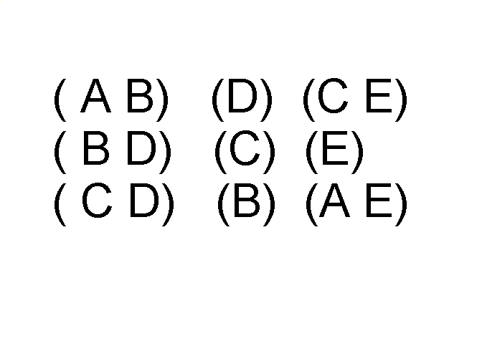
Ordered Data
Sequences of transactions
Items/Events
An element of the sequence

Slide 25
Ordered Data
Genomic sequence data

Slide 26
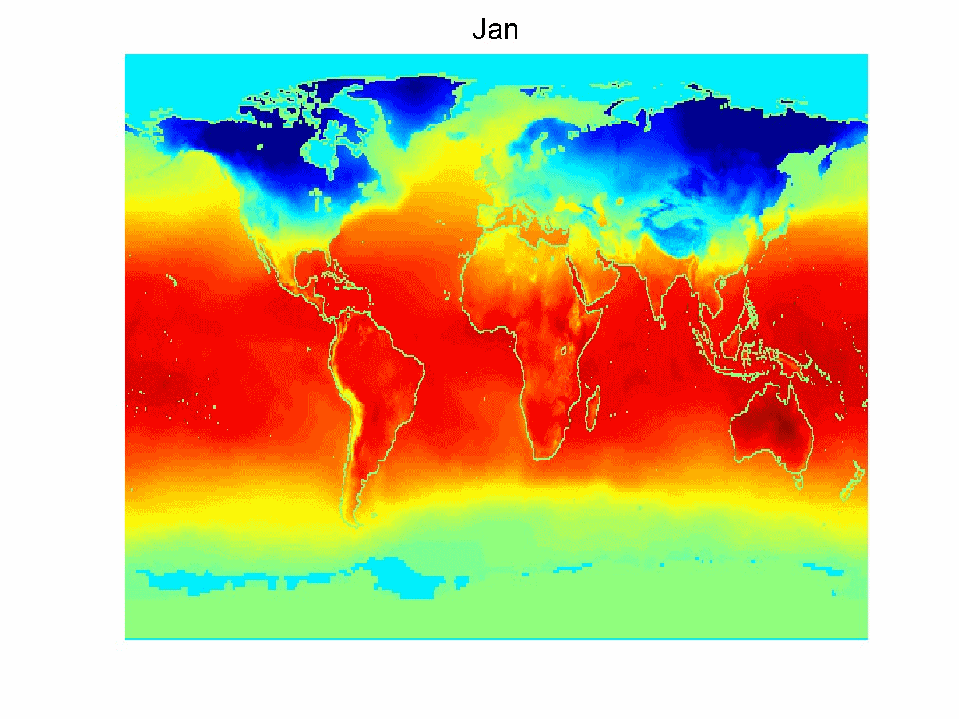
Ordered Data
Spatio-Temporal Data
Average Monthly Temperature of land and ocean

Slide 27
Data Quality
Poor data quality negatively affects many data processing efforts
“The most important point is that poor data quality is an unfolding disaster.
Poor data quality costs the typical company at least ten percent (10%) of revenue; twenty percent (20%) is probably a better estimate.”
Thomas C. Redman, DM Review, August 2004
Data mining example: a classification model for detecting people who are loan risks is built using poor data
Some credit-worthy candidates are denied loans
More loans are given to individuals that default

Slide 28
Data Quality …
What kinds of data quality problems?
How can we detect problems with the data?
What can we do about these problems?
Examples of data quality problems:
Noise and outliers
Missing values
Duplicate data
Wrong data

Slide 29
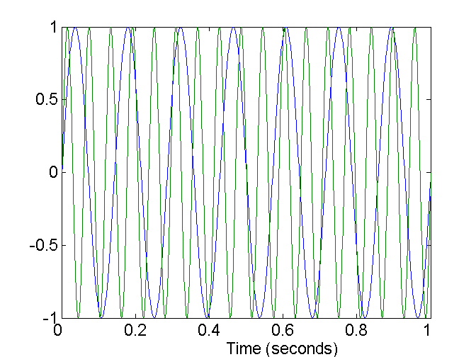
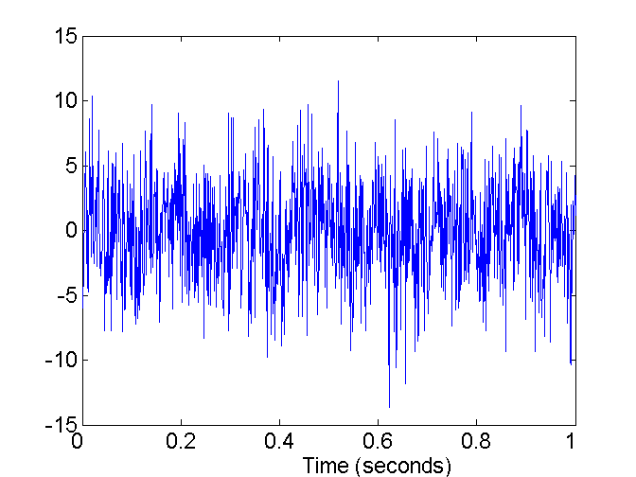
Noise
For objects, noise is an extraneous (外来的) object
For attributes, noise refers to modification of original values
Examples: distortion of a person’s voice when talking on a poor phone and “snow” on television screen
Two Sine Waves
Two Sine Waves + Noise

Slide 30

Outliers
Outliers are data objects with characteristics that are considerably different than most of the other data objects in the data set
Case 1: Outliers are noise that interferes with data analysis
Case 2: Outliers are the goal of our analysis
Credit card fraud
Intrusion detection
Causes?

Slide 31
Missing Values
Reasons for missing values
Information is not collected (e.g., people decline to give their age and weight)
Attributes may not be applicable to all cases (e.g., annual income is not applicable to children)
Handling missing values
Eliminate data objects or variables
Estimate missing values
Example: time series of temperature
Example: census results
Ignore the missing value during analysis

Slide 32
Missing Values …
Missing completely at random (MCAR)
Missingness of a value is independent of attributes
Fill in values based on the attribute
Analysis may be unbiased overall
Missing at Random (MAR)
Missingness is related to other variables
Fill in values based other values
Almost always produces a bias in the analysis
Missing Not at Random (MNAR)
Missingness is related to unobserved measurements
Informative or non-ignorable missingness
Not possible to know the situation from the data

Slide 33
Duplicate Data
Data set may include data objects that are duplicates, or almost duplicates of one another
Major issue when merging data from heterogeneous sources
Examples:
Same person with multiple email addresses
Data cleaning
Process of dealing with duplicate data issues
When should duplicate data not be removed?

Slide 34
Similarity and Dissimilarity Measures
Similarity measure
Numerical measure of how alike two data objects are.
Is higher when objects are more alike.
Often falls in the range [0,1]
Dissimilarity measure
Numerical measure of how different two data objects are
Lower when objects are more alike
Minimum dissimilarity is often 0
Upper limit varies
Proximity refers to a similarity or dissimilarity

Slide 35
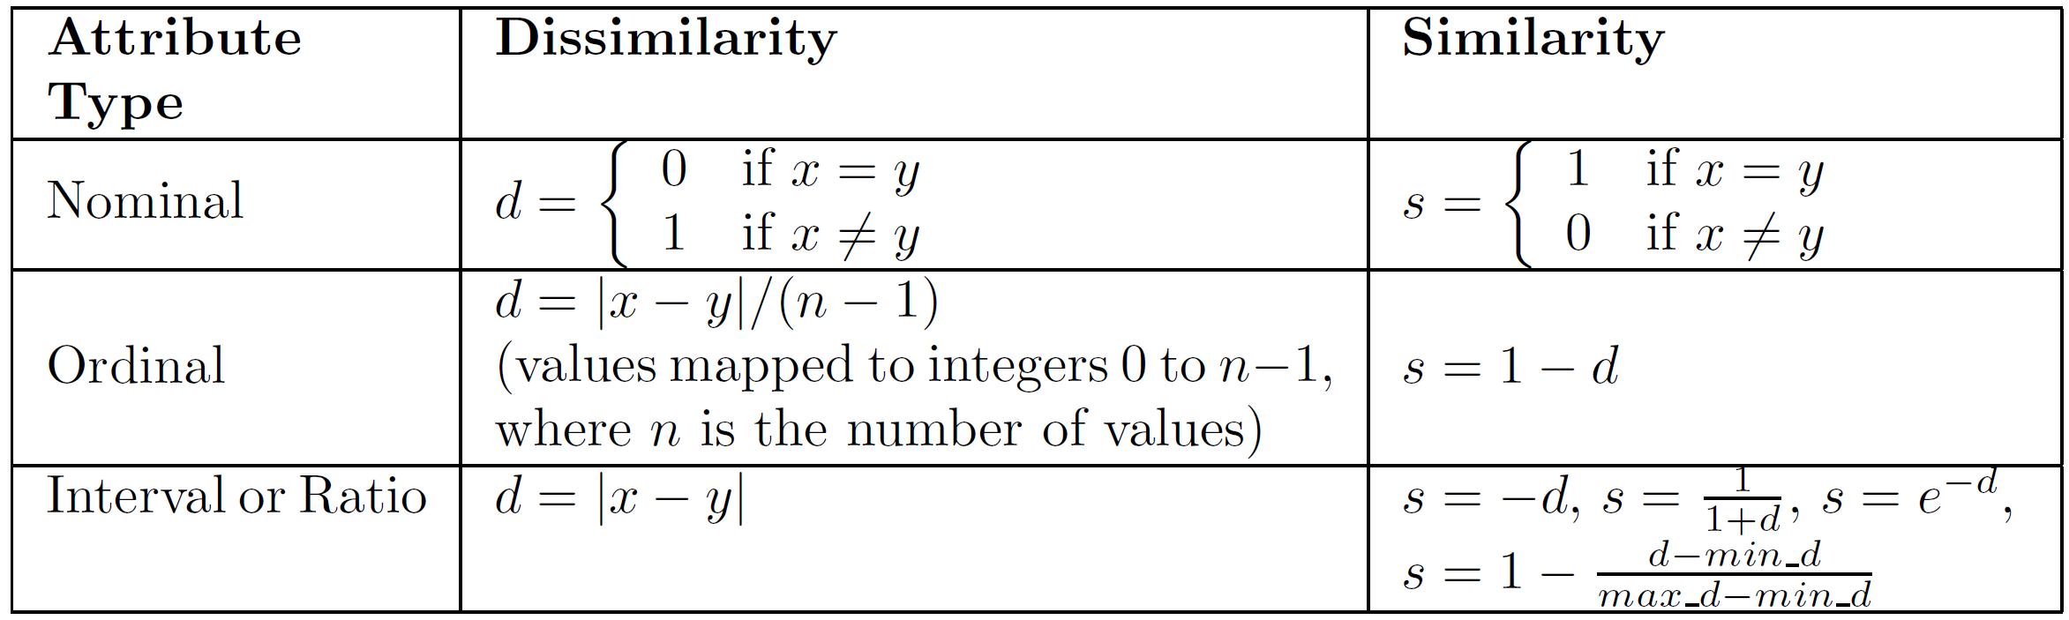
Similarity/Dissimilarity for Simple Attributes
The following table shows the similarity and dissimilarity between two objects, x and y, with respect to a single, simple attribute.

Slide 36
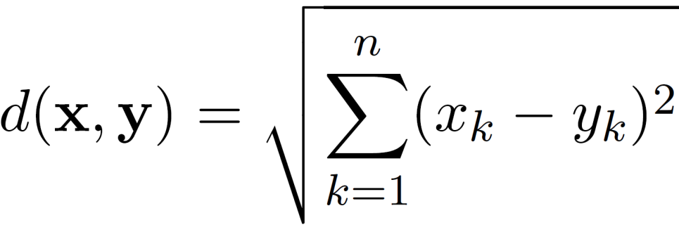
Euclidean Distance
Euclidean Distance
where n is the number of dimensions (attributes) and x_{k} and y_{k} are, respectively, the k^{th} attributes (components) or data objects x and y.
Standardization is necessary, if scales differ.

Slide 37
Euclidean Distance
Distance Matrix

Slide 38
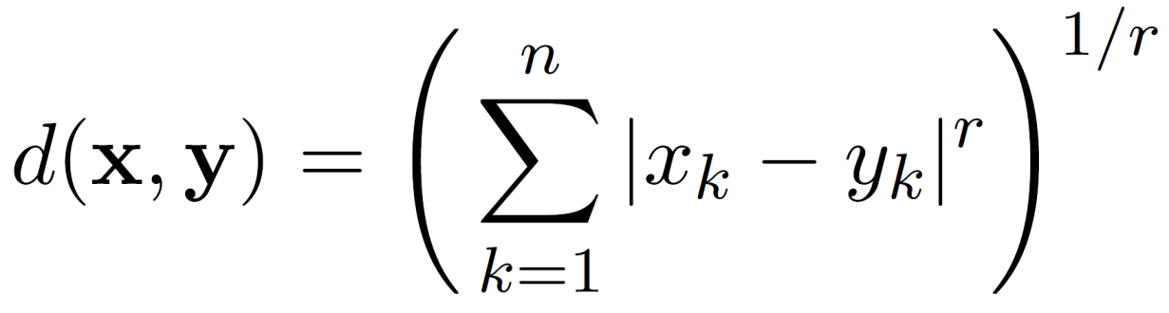
Minkowski Distance(明氏距离/明可夫斯基距离)
Minkowski Distance is a generalization of Euclidean Distance
Where r is a parameter, n is the number of dimensions (attributes) and x_{k} and y_{k} are, respectively, the k^{th} attributes (components) or data objects x and y.

Slide 39
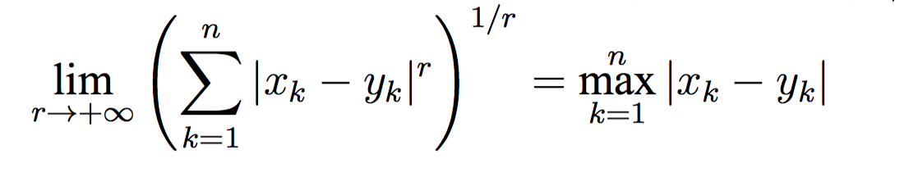
Minkowski Distance: Examples
r = 1. City block (Manhattan(曼哈顿), taxicab, L₁ norm) distance.
A common example of this is the Hamming distance, which is just the number of bits that are different between two binary vectors
r = 2. Euclidean distance
r → ∞. “supremum” (Chebyshev(切比雪夫), L_{max} norm, L∞ norm) distance.
This is the maximum difference between any component of the vectors
Do not confuse r with n, i.e., all these distances are defined for all numbers of dimensions.

Slide 40
Minkowski Distance
Distance Matrix

Slide 41
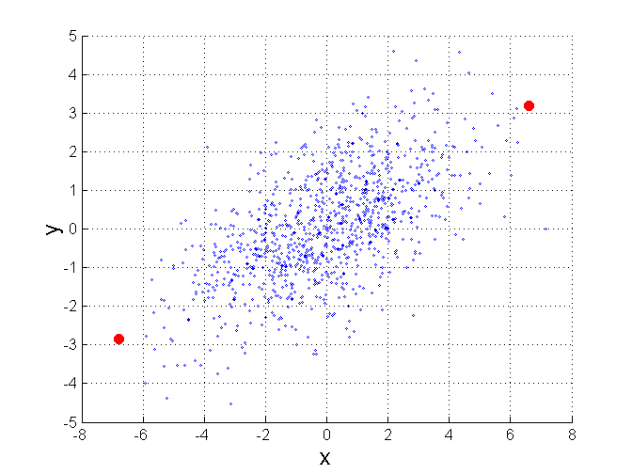
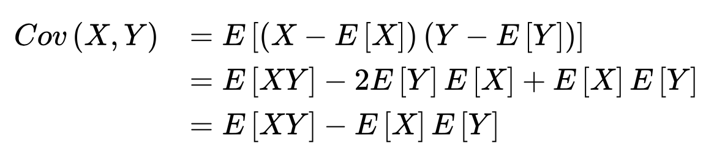
Mahalanobis Distance(马哈拉诺比斯距离)
$$mahalanobis\left(x,y\right)={ (x−y)}^{T}Ʃ^{−1}(x−y)$$
Σ is the covariance matrix
For red points, the Euclidean distance is 14.7, Mahalanobis distance is 6.

Slide 42
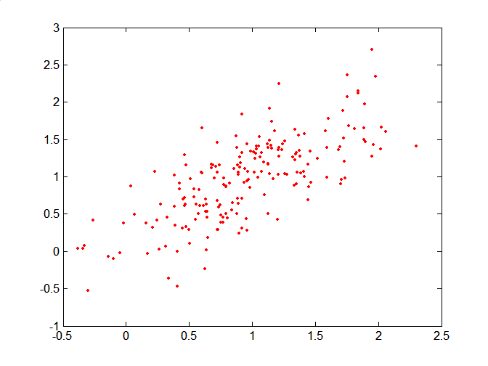
Mahalanobis Distance
Covariance Matrix:
C
B
A: (0.5, 0.5)
B: (0, 1)
C: (1.5, 1.5)
Mahal(A,B) = 5
Mahal(A,C) = 4
A

Slide 43
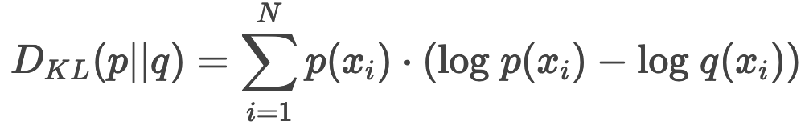
Common Properties of a Distance
Distances, such as the Euclidean distance, have some well known properties.
d(x, y) ≥ 0 for all x and y and d(x, y) = 0 only if x = y. (Positive definiteness)
d(x, y) = d(y, x) for all x and y. (Symmetry)
d(x, z) ≤ d(x, y) + d(y, z) for all points x, y, and z. (Triangle Inequality)
where d(x, y) is the distance (dissimilarity) between points (data objects), x and y.
A distance that satisfies these properties is a metric
Is Kullback–Leibler divergence a metric? Why?

Slide 44
Common Properties of a Similarity
Similarities, also have some well known properties.
s(x, y) = 1 (or maximum similarity) only if x = y.
s(x, y) = s(y, x) for all x and y. (Symmetry)
where s(x, y) is the similarity between points (data objects), x and y.

Slide 45
Similarity Between Binary Vectors
Common situation is that objects, p and q, have only binary attributes
Compute similarities using the following quantities
f₀₁ = the number of attributes where p was 0 and q was 1
f₁₀ = the number of attributes where p was 1 and q was 0
f₀₀ = the number of attributes where p was 0 and q was 0
f₁₁ = the number of attributes where p was 1 and q was 1
Simple Matching and Jaccard (雅卡尔) Coefficients
SMC = number of matches / number of attributes
= (f₁₁ + f₀₀) / (f₀₁ + f₁₀ + f₁₁ + f₀₀)
J = number of 11 matches / number of non-zero attributes
= (f₁₁) / (f₀₁ + f₁₀ + f₁₁)

Slide 46
SMC versus Jaccard: Example
x = 1 0 0 0 0 0 0 0 0 0
y = 0 0 0 0 0 0 1 0 0 1
f₀₁ = 2 (the number of attributes where p was 0 and q was 1)
f₁₀ = 1 (the number of attributes where p was 1 and q was 0)
f₀₀ = 7 (the number of attributes where p was 0 and q was 0)
f₁₁ = 0 (the number of attributes where p was 1 and q was 1)
SMC = (f₁₁ + f₀₀) / (f₀₁ + f₁₀ + f₁₁ + f₀₀)
= (0+7) / (2+1+0+7) = 0.7
J = (f₁₁) / (f₀₁ + f₁₀ + f₁₁) = 0 / (2 + 1 + 0) = 0

Slide 47
Cosine Similarity
If d₁ and d₂ are two document vectors, then
cos( d₁, d₂ ) = <d₁,d₂> / ||d₁|| ||d₂|| ,
where <d₁,d₂> indicates inner product or vector dot product of vectors, d₁ and d_{2,} and || d || is the length of vector d.
Example:
d₁ = 3 2 0 5 0 0 0 2 0 0
d₂ = 1 0 0 0 0 0 0 1 0 2
<d₁, d2> = 3*1 + 2*0 + 0*0 + 5*0 + 0*0 + 0*0 + 0*0 + 2*1 + 0*0 + 0*2 = 5
|| d₁ || = (3*3+2*2+0*0+5*5+0*0+0*0+0*0+2*2+0*0+0*0)^{0.5} = (42) ^{0.5} = 6.481
|| d₂ || = (1*1+0*0+0*0+0*0+0*0+0*0+0*0+1*1+0*0+2*2) ^{0.5} = (6) ^{0.5} = 2.449
cos(d₁, d₂ ) = 0.3150

Slide 48
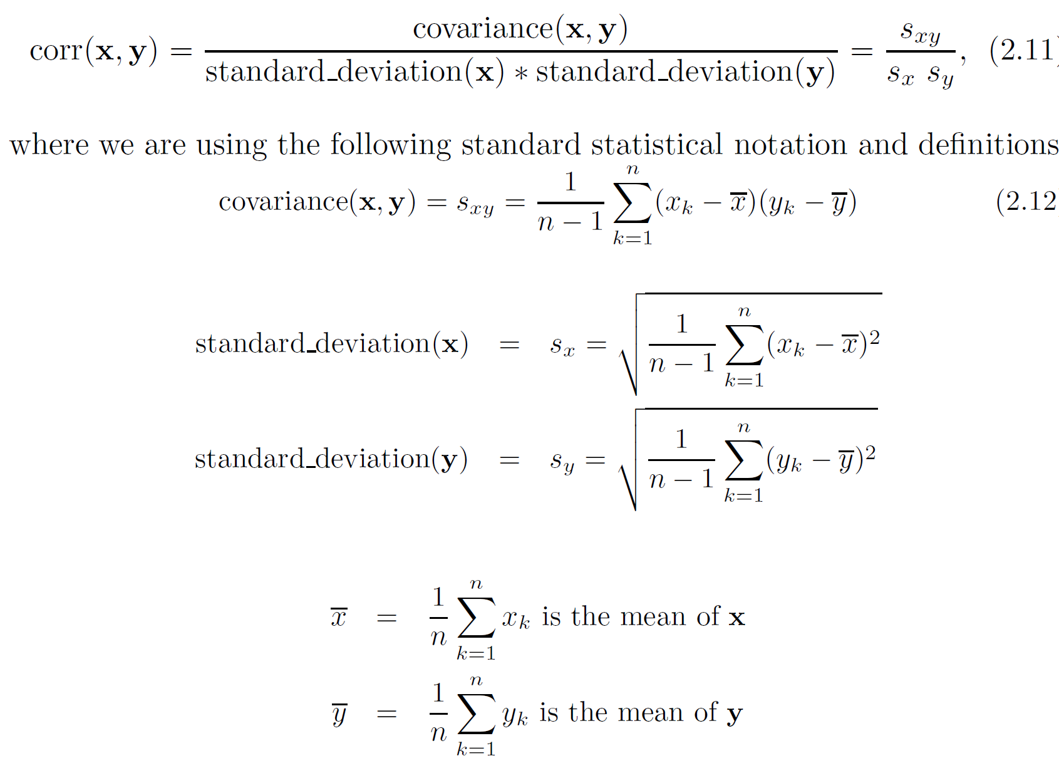
Correlation measures the linear relationship between objects

Slide 49
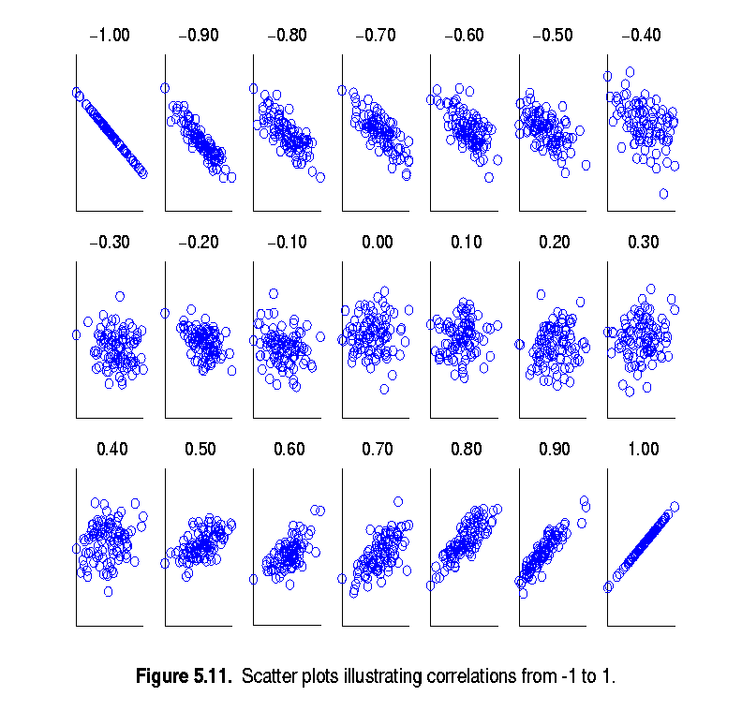
Visually Evaluating Correlation
Scatter plots showing the similarity from –1 to 1.

Slide 50
Drawback of Correlation
x = (-3, -2, -1, 0, 1, 2, 3)
y = (9, 4, 1, 0, 1, 4, 9)
y_{i} = x_{i}²
mean(x) = 0, mean(y) = 4
std(x) = 2.16, std(y) = 3.74
corr = (-3)(5)+(-2)(0)+(-1)(-3)+(0)(-4)+(1)(-3)+(2)(0)+3(5) / ( 6 * 2.16 * 3.74 )
= 0

Slide 51
Comparison of Proximity Measures
Domain of application
Similarity measures tend to be specific to the type of attribute and data
Record data, images, graphs, sequences, 3D-protein structure, etc. tend to have different measures
However, one can talk about various properties that you would like a proximity measure to have
Symmetry is a common one
Tolerance to noise and outliers is another
Ability to find more types of patterns?
Many others possible
The measure must be applicable to the data and produce results that agree with domain knowledge

Slide 52
Information Based Measures
Information theory is a well-developed and fundamental disciple with broad applications
Some similarity measures are based on information theory
Mutual information in various versions
General and can handle non-linear relationships
Can be complicated and time intensive to compute

Slide 53
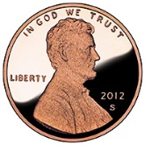

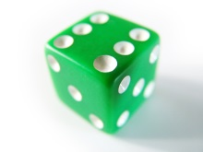
Information and Probability
Information relates to possible outcomes of an event
transmission of a message, flip of a coin, or measurement of a piece of data
The more certain an outcome, the less information that it contains and vice-versa
For example, if a coin has two heads, then an outcome of heads provides no information
More quantitatively, the information is related the probability of an outcome
The smaller the probability of an outcome, the more information it provides and vice-versa
Entropy is the commonly used measure

Slide 54
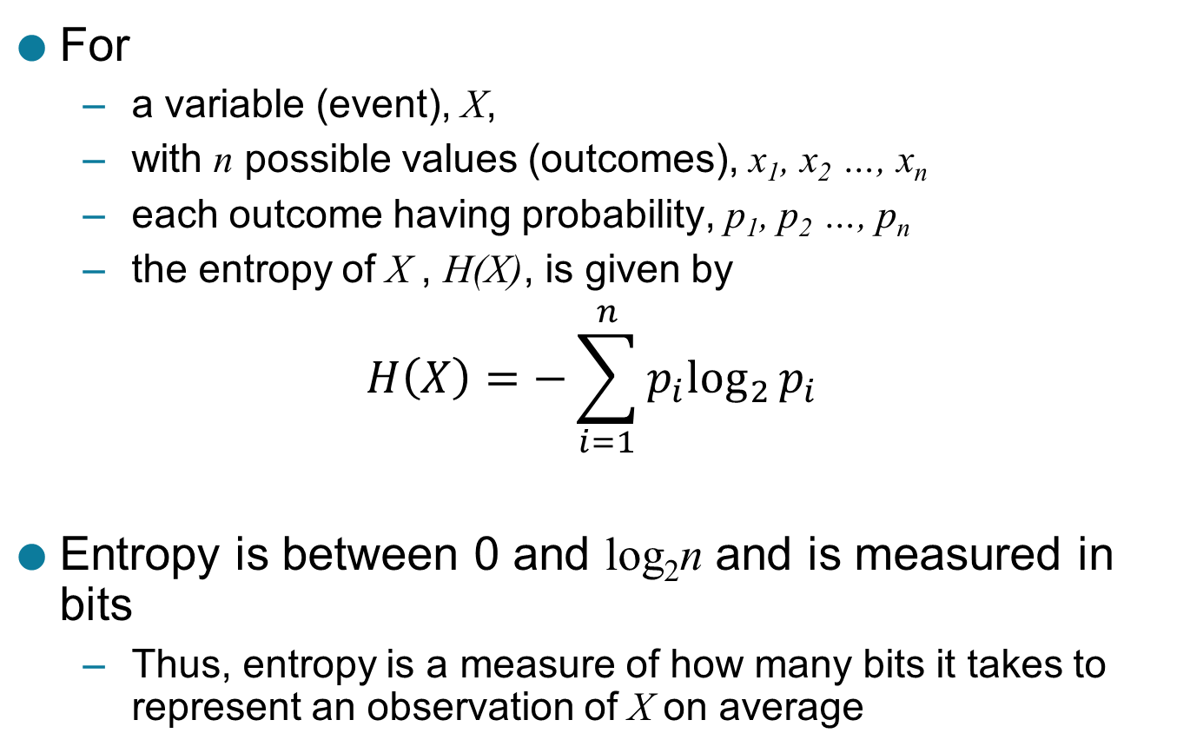
Entropy
For
a variable (event), X,
with n possible values (outcomes), x₁, x₂ …, x_{n}
each outcome having probability, p₁, p₂ …, p_{n}
the entropy of X , H(X), is given by
$$H\left(X\right)=−\sum_{i=1}^{n}{{p_{i}log}_{2}{p_{i}}}$$
Entropy is between 0 and log₂n and is measured in bits
Thus, entropy is a measure of how many bits it takes to represent an observation of X on average

Slide 55
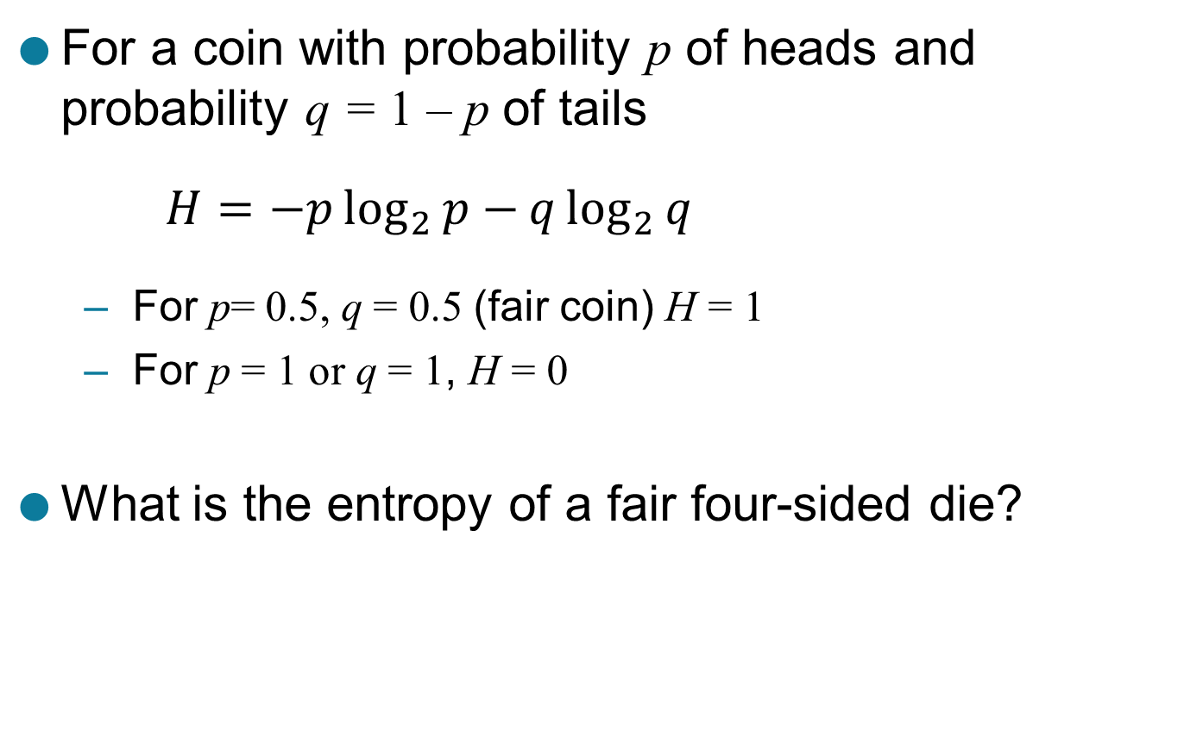
Entropy Examples
For a coin with probability p of heads and probability q = 1 – p of tails
$$H=−p\log_{2}{p−}q\log_{2}{q}$$
For p= 0.5, q = 0.5 (fair coin) H = 1
For p = 1 or q = 1, H = 0
What is the entropy of a fair four-sided die?

Slide 56
Entropy for Sample Data: Example
Maximum entropy is log₂5 = 2.3219
Hair Color | Count | p | -plog₂p
Black | 75 | 0.75 | 0.3113
Brown | 15 | 0.15 | 0.4105
Blond | 5 | 0.05 | 0.2161
Red | 0 | 0.00 | 0
Other | 5 | 0.05 | 0.2161
Total | 100 | 1.0 | 1.1540

Slide 57
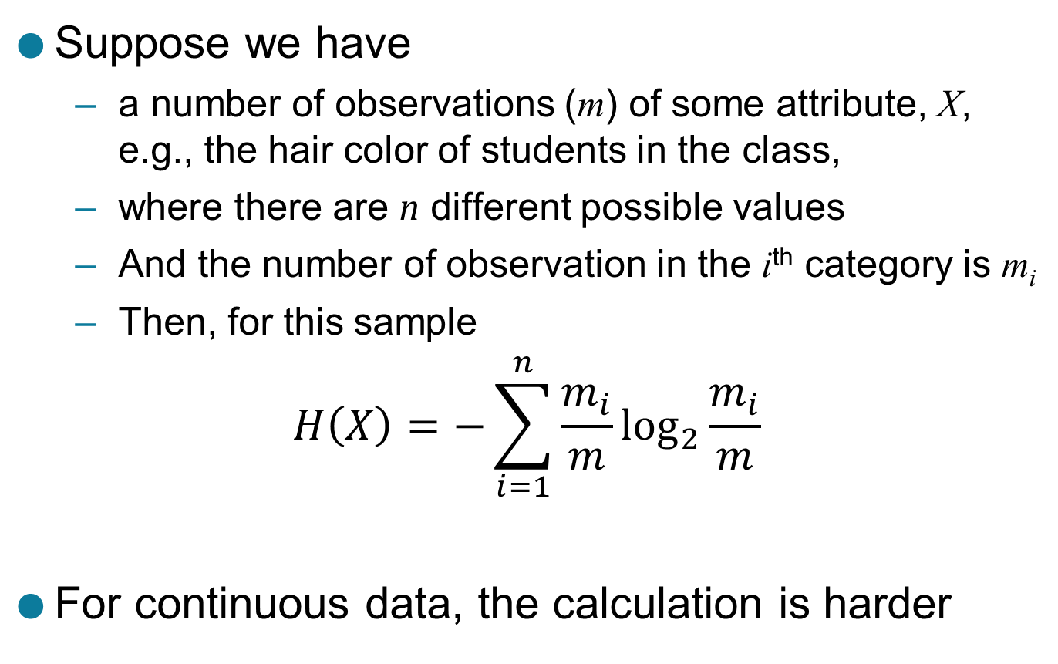
Entropy for Sample Data
Suppose we have
a number of observations (m) of some attribute, X, e.g., the hair color of students in the class,
where there are n different possible values
And the number of observation in the i^{th} category is m_{i}
Then, for this sample
$$H\left(X\right)=−\sum_{i=1}^{n}{{\frac{m_{i}}{m}log}_{2}{\frac{m_{i}}{m}}}$$
For continuous data, the calculation is harder

Slide 58
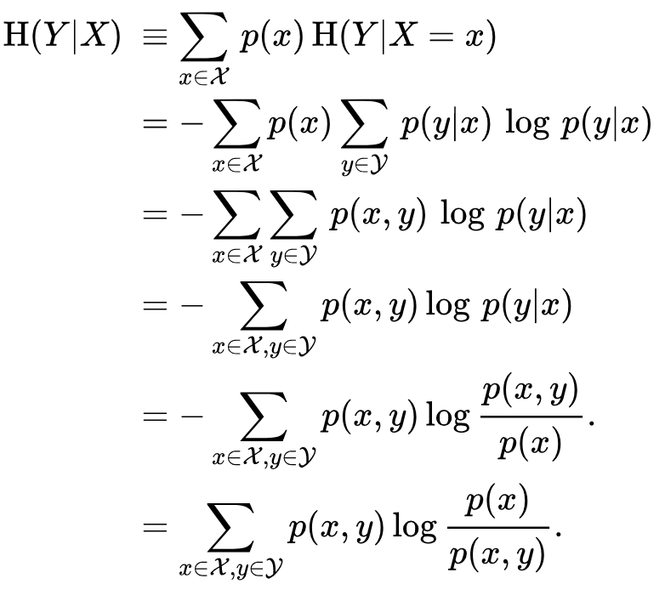
Conditional Entropy

Slide 59
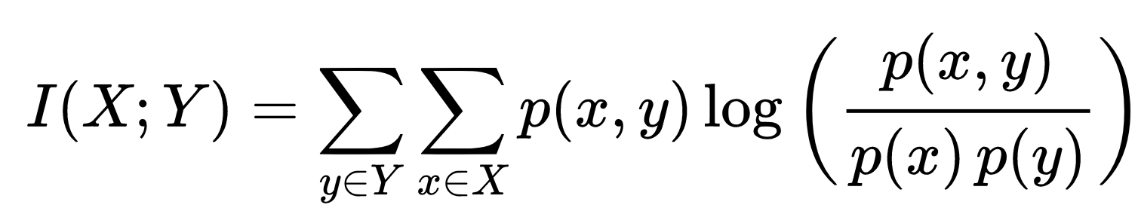
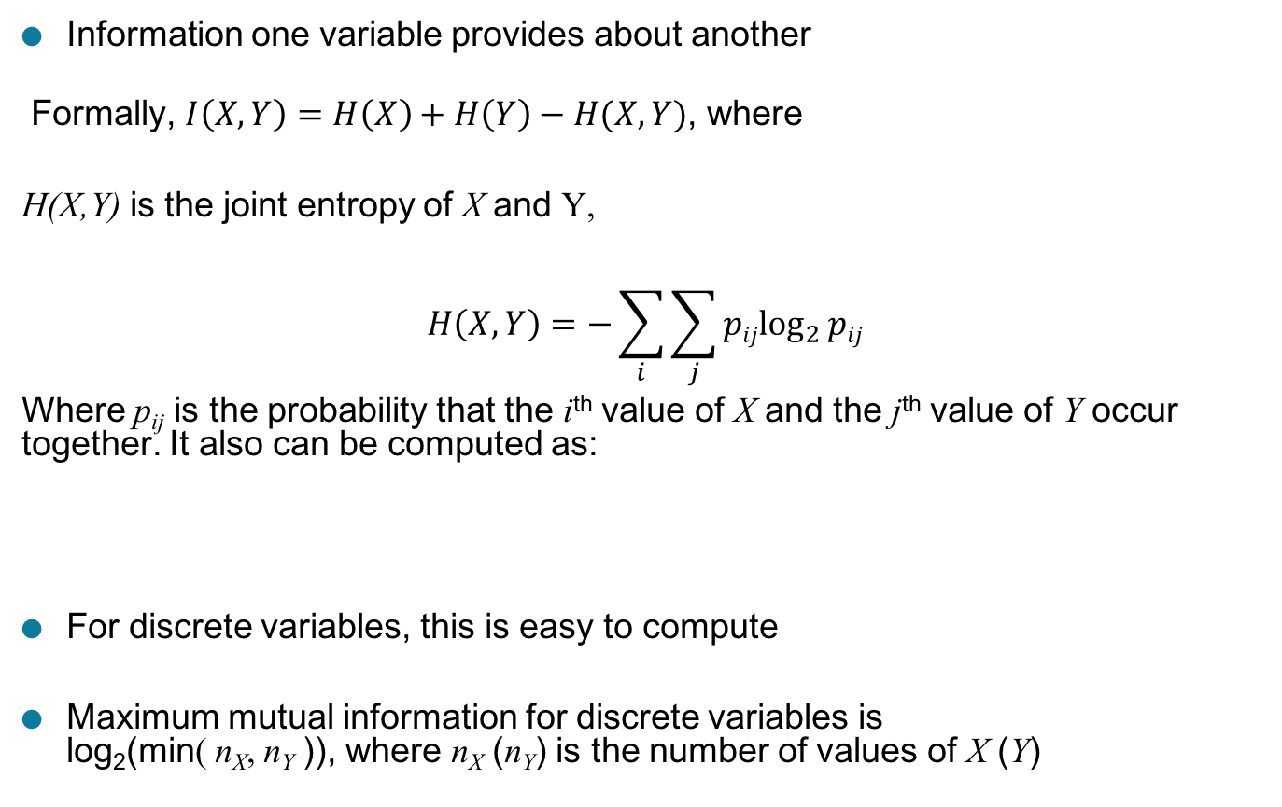
Mutual Information
Information one variable provides about another
Formally, $I\left(X,Y\right)=H\left(X\right)+H\left(Y\right)−H(X,Y)$, where
H(X,Y) is the joint entropy of X and Y,
$$H\left(X,Y\right)=−\sum_{i}{\sum_{j}{{pijlog}_{2}{pij}}}$$
Where p_{ij} is the probability that the i^{th} value of X and the j^{th} value of Y occur together. It also can be computed as:
For discrete variables, this is easy to compute
Maximum mutual information for discrete variables is log₂(min( n_{X}, n_{Y} )), where n_{X} (n_{Y}) is the number of values of X (Y)

Slide 60
Mutual Information Example
Student Status | Count | p | -plog₂p
Undergrad | 45 | 0.45 | 0.5184
Grad | 55 | 0.55 | 0.4744
Total | 100 | 1.00 | 0.9928
Student Status | Grade | Count | p | -plog₂p
Undergrad | A | 5 | 0.05 | 0.2161
Undergrad | B | 30 | 0.30 | 0.5211
Undergrad | C | 10 | 0.10 | 0.3322
Grad | A | 30 | 0.30 | 0.5211
Grad | B | 20 | 0.20 | 0.4644
Grad | C | 5 | 0.05 | 0.2161
Total |  | 100 | 1.00 | 2.2710
Grade | Count | p | -plog₂p
A | 35 | 0.35 | 0.5301
B | 50 | 0.50 | 0.5000
C | 15 | 0.15 | 0.4105
Total | 100 | 1.00 | 1.4406
Mutual information of Student Status and Grade = 0.9928 + 1.4406 - 2.2710 = 0.1624

Slide 61
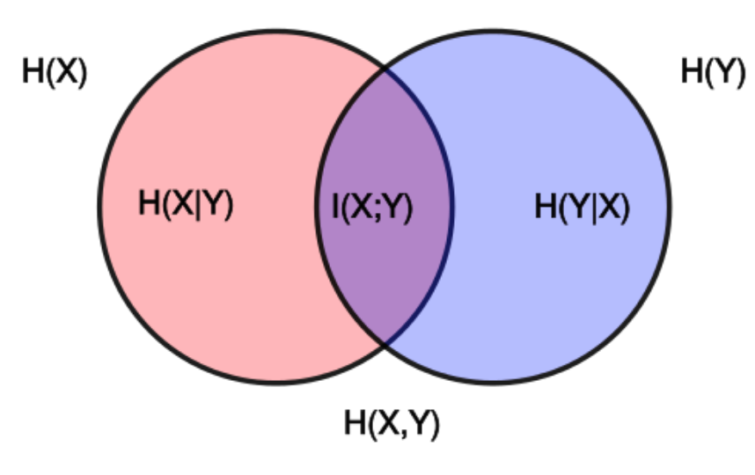
Relationship

Slide 62
General Approach for Combining Similarities
Sometimes attributes are of many different types, but an overall similarity is needed.
1: For the k^{th} attribute, compute a similarity, s_{k}(x, y), in the range [0, 1].
2: Define an indicator variable, δ_{k}, for the k^{th} attribute as follows:
δ_{k} = 0 if the k^{th} attribute is an asymmetric attribute and
both objects have a value of 0, or if one of the objects has a missing value for the kth attribute
δ_{k} = 1 otherwise
3. Compute

Slide 63
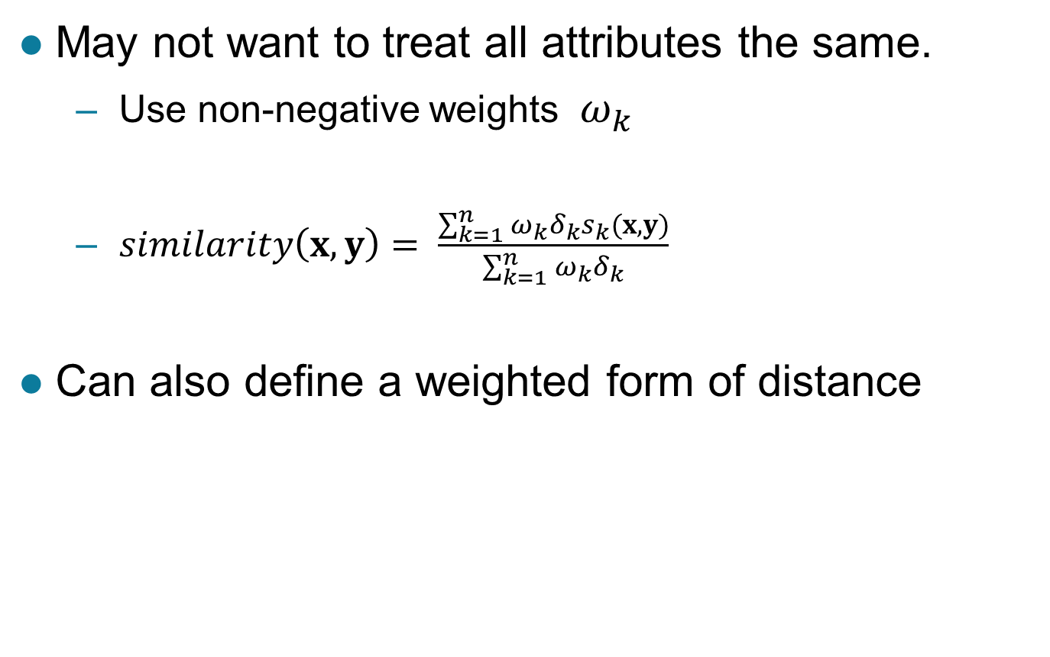
Using Weights to Combine Similarities
May not want to treat all attributes the same.
Use non-negative weights $ω_{k}$
$similarity\left(x,y\right)= \frac{\sum_{k=1}^{n}{ω_{k}δ_{k}s_{k}(x,y)}}{\sum_{k=1}^{n}{ω_{k}δ_{k}}}$
Can also define a weighted form of distance

Slide 64
Density
Measures the degree to which data objects are close to each other in a specified area
The notion of density is closely related to that of proximity
Concept of density is typically used for clustering and anomaly detection
Examples:
Euclidean density
Euclidean density = number of points per unit volume
Probability density
Estimate what the distribution of the data looks like
Graph-based density
Connectivity

Slide 65
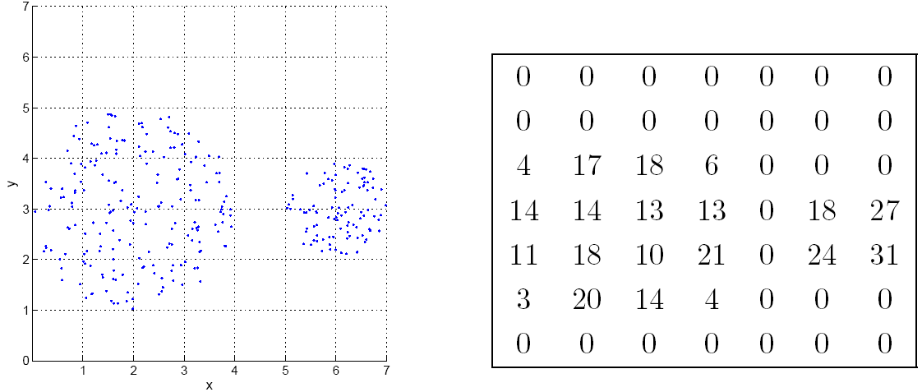
Euclidean Density: Grid-based Approach
Simplest approach is to divide region into a number of rectangular cells of equal volume and define density as # of points the cell contains
Grid-based density. Counts for each cell.

Slide 66
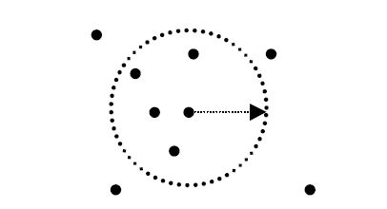
Euclidean Density: Center-Based
Euclidean density is the number of points within a specified radius of the point
Illustration of center-based density.

Slide 67
Data Preprocessing
Aggregation
Sampling
Dimensionality Reduction
Feature subset selection
Feature creation
Discretization and Binarization
Attribute Transformation

Slide 68
Aggregation
Combining two or more attributes (or objects) into a single attribute (or object)
Purpose
Data reduction
Reduce the number of attributes or objects
Change of scale
Cities aggregated into regions, states, countries, etc.
Days aggregated into weeks, months, or years
More “stable” data
Aggregated data tends to have less variability

Slide 69
Example: Precipitation in Australia
This example is based on precipitation (降雨量) in Australia from the period 1982 to 1993.
The next slide shows
A histogram for the standard deviation of average monthly precipitation for 3,030 0.5◦ by 0.5◦ grid cells in Australia, and
A histogram for the standard deviation of the average yearly precipitation for the same locations.
The average yearly precipitation has less variability than the average monthly precipitation.
All precipitation measurements (and their standard deviations) are in centimeters.

Slide 70
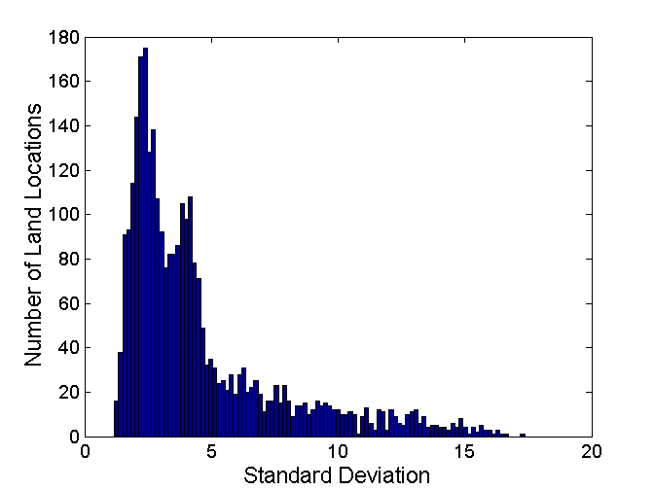
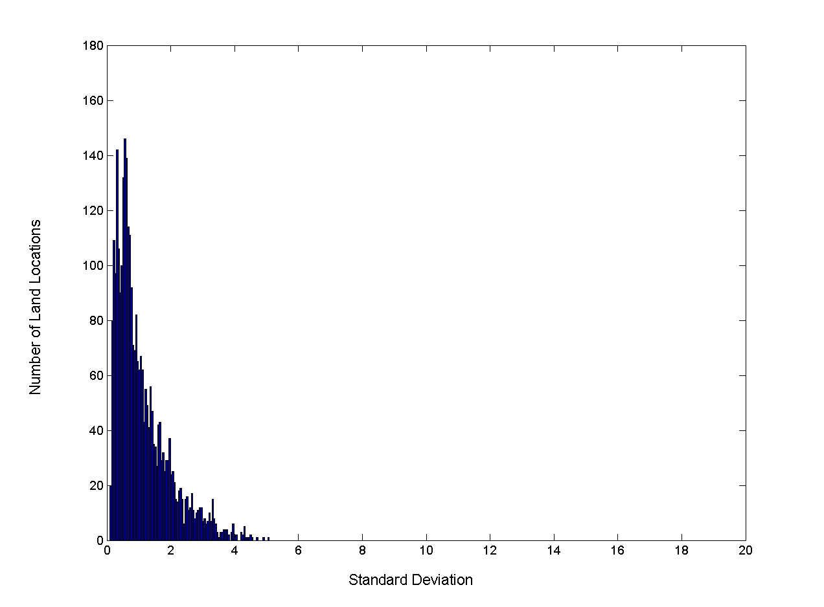
Example: Precipitation in Australia …
Variation of Precipitation in Australia
Standard Deviation of Average Monthly Precipitation
Standard Deviation of Average Yearly Precipitation

Slide 71
Sampling
Sampling is the main technique employed for data reduction.
It is often used for both the preliminary investigation of the data and the final data analysis.
Statisticians often sample because obtaining the entire set of data of interest is too expensive or time consuming.
Sampling is typically used in data mining because processing the entire set of data of interest is too expensive or time consuming.

Slide 72
Sampling …
The key principle for effective sampling is the following:
Using a sample will work almost as well as using the entire data set, if the sample is representative
A sample is representative if it has approximately the same properties (of interest) as the original set of data

Slide 73

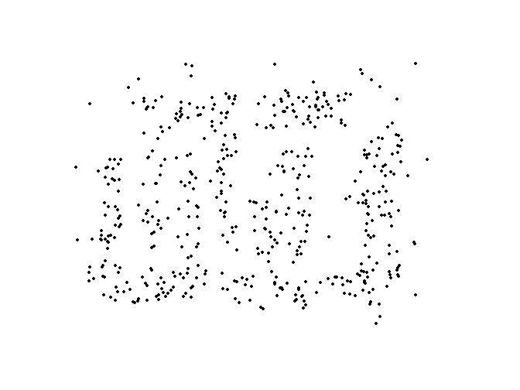
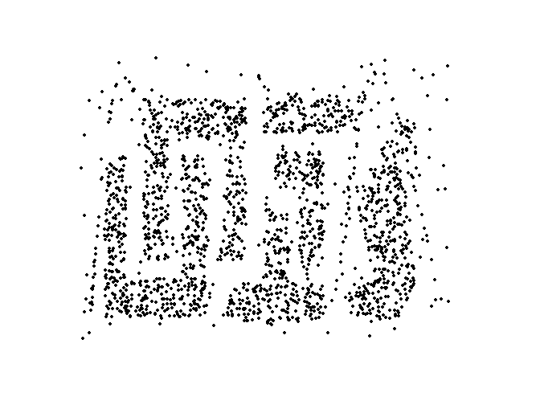
Sample Size
8000 points 2000 Points 500 Points

Slide 74
Types of Sampling
Simple Random Sampling
There is an equal probability of selecting any particular item
Sampling without replacement
As each item is selected, it is removed from the population
Sampling with replacement
Objects are not removed from the population as they are selected for the sample.
In sampling with replacement, the same object can be picked up more than once
Stratified (层级的) sampling
Split the data into several partitions; then draw random samples from each partition

Slide 75
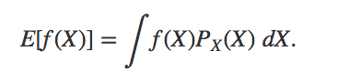
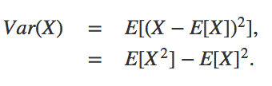
Monte Carlo Methods
Monte Carlo Estimator: Evaluating Integrals

Slide 76
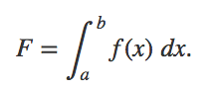
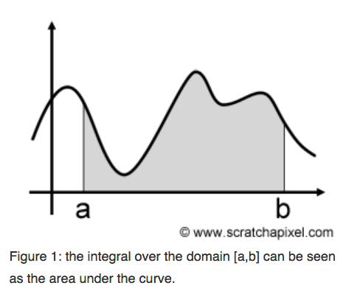
Monte Carlo Methods
Image that we want to integrate a one-dimensional function f(x) from a to b :

Slide 77
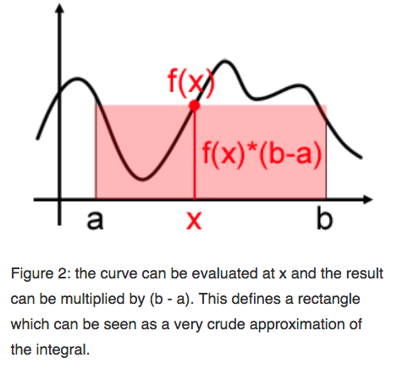
Monte Carlo Methods
Image that we want to integrate a one-dimensional function f(x) from a to b :

Slide 78
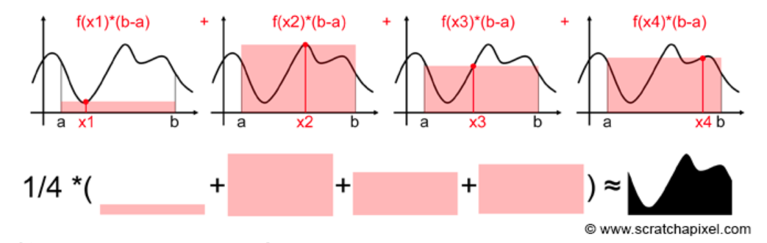
Monte Carlo Methods
Image that we want to integrate a one-dimensional function f(x) from a to b :

Slide 79
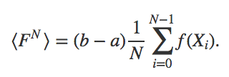
Monte Carlo Methods
We can formalize this idea with the following formula:
Basic Monte Carlo Estimator

Slide 80
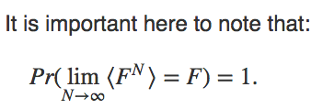
Monte Carlo Methods
Image that we want to integrate a one-dimensional function f(x) from a to b :

Slide 81
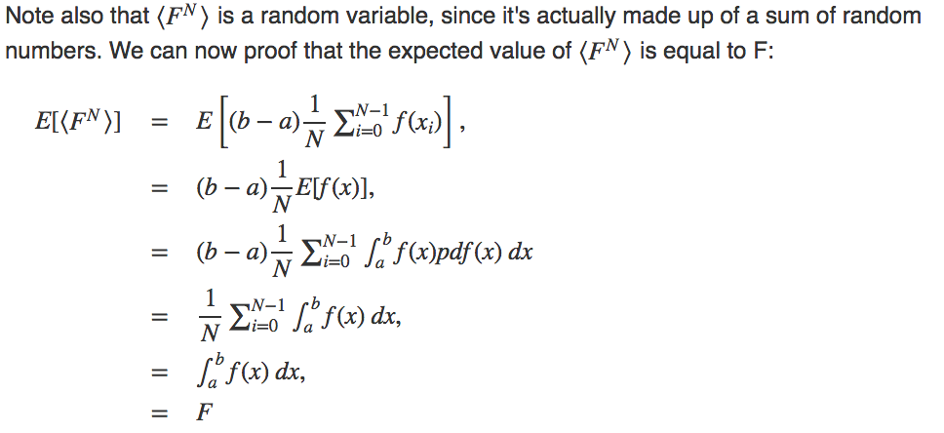
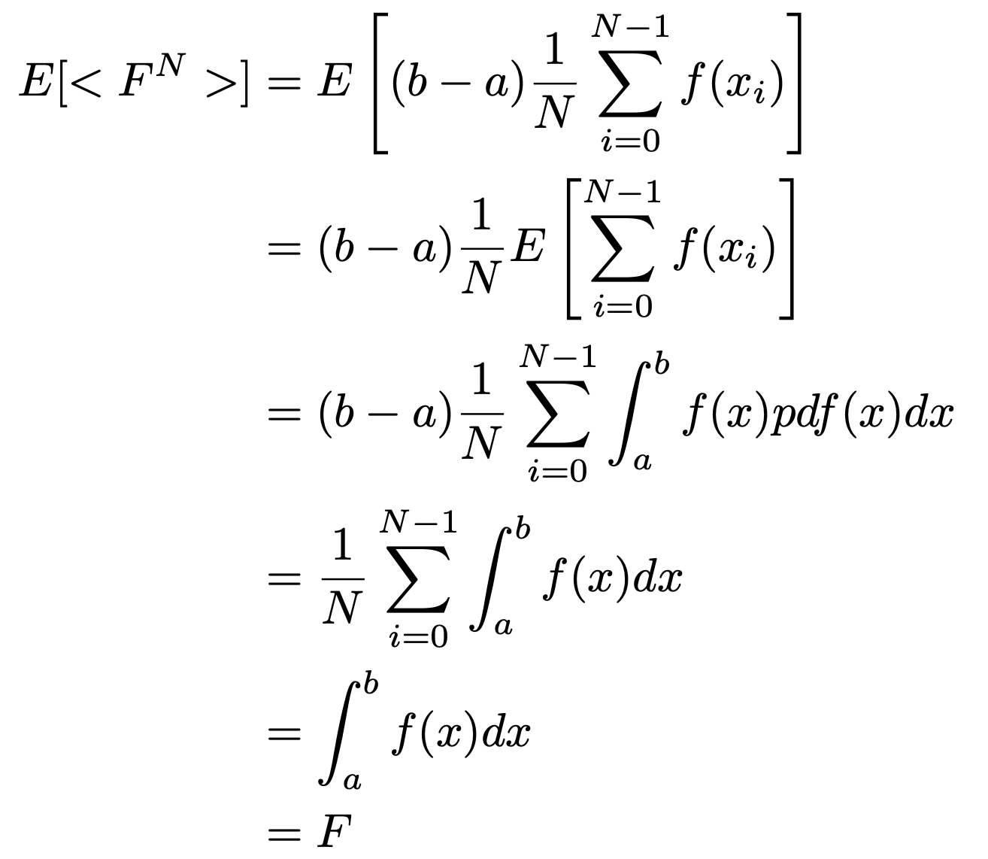
Monte Carlo Methods

Slide 82
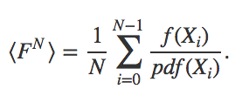
Monte Carlo Methods
Generalization to Arbitrary PDF
We can extend Monte Carlo integration to random variables with arbitrary PDFs. The more generic formula is then:
The pdf in the denominator is the same as the pdf of the random variable X

Slide 83
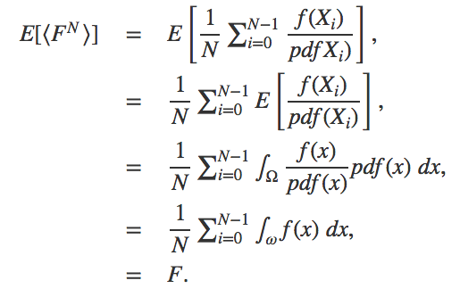
Monte Carlo Methods
Generalization to Arbitrary PDF
We can extend Monte Carlo integration to random variables with arbitrary PDFs. The more generic formula is then:

Slide 84
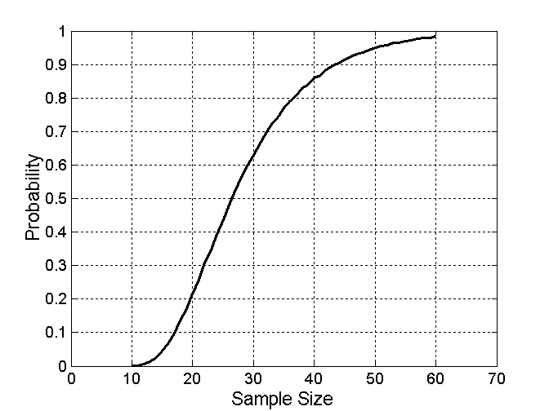
Sample Size
What sample size is necessary to get at least one object from each of 10 equal-sized groups.

Slide 85
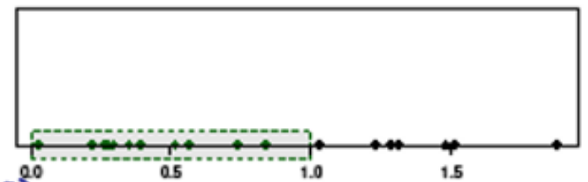
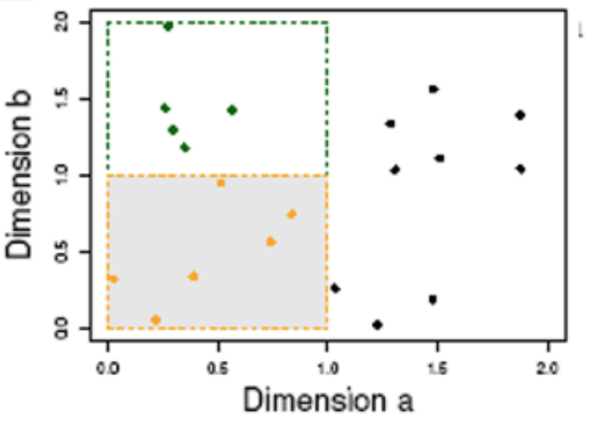
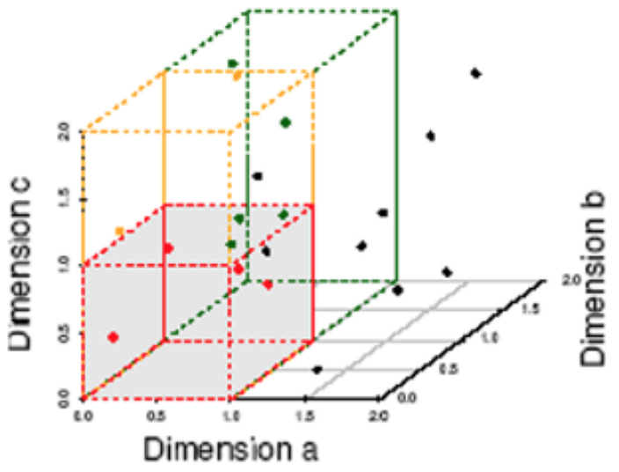
Curse of Dimensionality
Data in only one dimension is relatively packed
Adding a dimension “stretch” the points across the dimension, making them further apart
Adding more dimensions will make the points further apart—high dimensional data is extremely sparse
Distance measure become meaningless—due to equi-distance
(a) Many objects in one unit bin
(b) 6 objects in one unit bin
(c) 4 objects in one unit bin

Slide 86
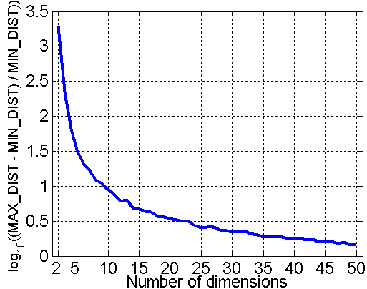
Curse of Dimensionality
When dimensionality increases, data becomes increasingly sparse in the space that it occupies
Definitions of density and distance between points, which are critical for clustering and outlier detection, become less meaningful
Randomly generate 500 points
Compute difference between max and min distance between any pair of points

Slide 87
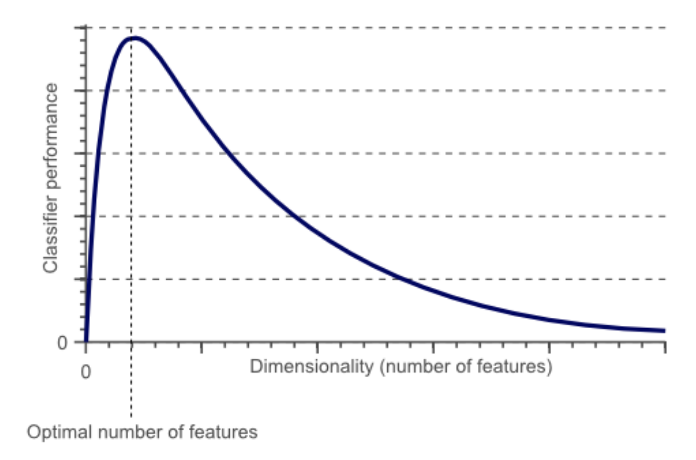
Curse of Dimensionality

Slide 88
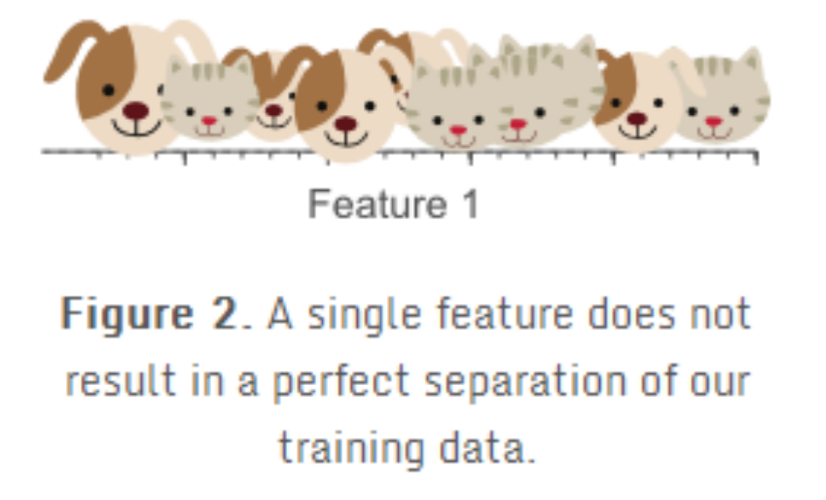
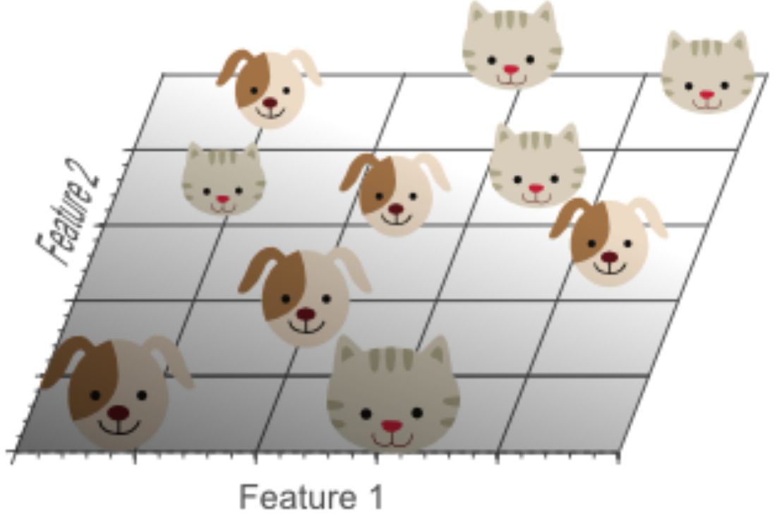
Curse of Dimensionality

Slide 89


Curse of Dimensionality
https://www.visiondummy.com/2014/04/curse-dimensionality-affect-classification/
https://zhuanlan.zhihu.com/p/27488363

Slide 90
Dimensionality Reduction
Purpose:
Avoid curse of dimensionality
Reduce amount of time and memory required by data mining algorithms
Allow data to be more easily visualized
May help to eliminate irrelevant features or reduce noise
Techniques
Principal Components Analysis (PCA)
Singular Value Decomposition
Others: supervised and non-linear techniques

Slide 91
Dimensionality Reduction: PCA
Goal is to find a projection that captures the largest amount of variation in data
x₂
e
x₁

Slide 92





Dimensionality Reduction: PCA

Slide 93
Feature Subset Selection
Another way to reduce dimensionality of data
Redundant features
Duplicate much or all of the information contained in one or more other attributes
Example: purchase price of a product and the amount of sales tax paid
Irrelevant features
Contain no information that is useful for the data mining task at hand
Example: students' ID is often irrelevant to the task of predicting students' GPA
Many techniques developed, especially for classification

Slide 94
Feature Creation
Create new attributes that can capture the important information in a data set much more efficiently than the original attributes
Three general methodologies:
Feature extraction
Example: extracting edges from images
Feature construction
Example: dividing mass by volume to get density
Mapping data to new space
Example: Fourier and wavelet analysis

Slide 95

Mapping Data to a New Space
Fourier and wavelet transform
Frequency
Two Sine Waves + Noise
Frequency

Slide 96
Discretization
Discretization is the process of converting a continuous attribute into an ordinal attribute
A potentially infinite number of values are mapped into a small number of categories
Discretization is commonly used in classification
Many classification algorithms work best if both the independent and dependent variables have only a few values
We give an illustration of the usefulness of discretization using the Iris data set

Slide 97
Binarization
Binarization maps a continuous or categorical attribute into one or more binary variables
Typically used for association analysis
Often convert a continuous attribute to a categorical attribute and then convert a categorical attribute to a set of binary attributes
Association analysis needs asymmetric binary attributes
Examples: eye color and height measured as {low, medium, high}

Slide 98
Attribute Transformation
An attribute transform is a function that maps the entire set of values of a given attribute to a new set of replacement values such that each old value can be identified with one of the new values
Simple functions: x^{k}, log(x), e^{x}, |x|
Normalization
Refers to various techniques to adjust to differences among attributes in terms of frequency of occurrence, mean, variance, range
Take out unwanted, common signal, e.g., seasonality
In statistics, standardization refers to subtracting off the means and dividing by the standard deviation

Slide 99
Thank You!

